Slide 1
CIS387/ECE387
Digital Forensics I
Encase Forensics Concepts
Notes:
Guide to Computer Forensics and Investigations Fifth Edition
Chapter 3
Data Acquisition

Slide 2
What is Encase
EnCase Forensic is the industry standard in computer forensic investigation technology.
Encase is a single tool, capable of conducting large-scale and complex investigations from beginning to end.
By Guidance Software, Inc.
Notes:
Can do the analysis and report all in the same tool.
Can get certified in Encase tool.

Slide 3
Who Can use Encase
Law enforcement officers
Government investigators
Corporate investigators
Consultants

Slide 4
Features
Acquire data in a forensically sound manner using software with an unparalleled record in courts worldwide.
Investigate and analyze multiple platforms — Windows, Linux, AIX, OS X, Solaris and more — using a single tool.
Save days, if not weeks, of analysis time by automating complex and routine tasks with prebuilt EnScript® modules, such as Initialized Case and Event Log analysis.
Find information despite efforts to hide, cloak or delete.
Notes:
.E01 is the file extension for first segment of an image file
New Encase evidence file format is .EX01 for first segment of image file.

Slide 5
Features
Easily manage large volumes of computer evidence, viewing all relevant files, including "deleted" files, file slack and unallocated space.
Transfer evidence files directly to law enforcement or legal representatives as necessary.
Review options allow non-investigators, such as attorneys, to review evidence with ease.
Reporting options enable quick report preparation

Slide 6
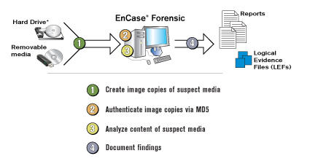
How Encase works

Slide 7
File systems supported by EnCase software:
FAT12/16/32, NTFS, EXT2/3 (Linux), Reiser (Linux), UFS (Sun Solaris), AIX Journaling File System (JFS and jfs) LVM8, FFS (OpenBSD, NetBSD and FreeBSD), Palm, HFS, HFS+ (Macintosh), CDFS, ISO 9660, UDF, DVD, ad TiVo® 1 and TiVo 2 file systems

Slide 8
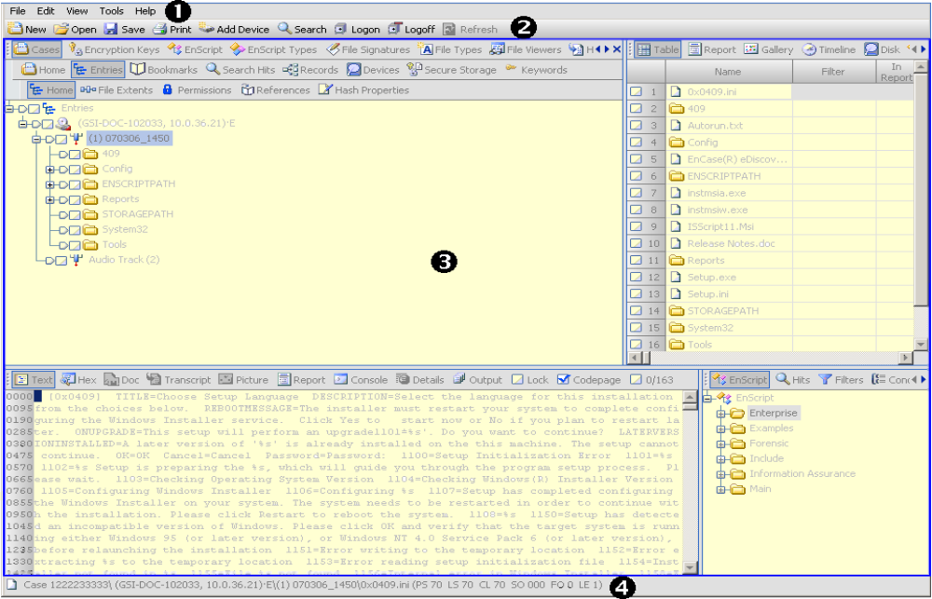
Encase Interface:

Slide 9
Forensically Sound Acquisitions and Examinations
Forensically sound acquisition
  Binary duplicate of the original drive or media
  Generating MD5 or SHA-1 hash values for verification
Forensically sound examination
  Examination using EnCase incapable of changing any data on the evidence file (the software implements software write block)

Slide 10
EnCase Evidence File
May consist of multiple segments, with the extension documenting the order of the segments
EnCase v7 supports two different formats:
  Legacy format: .E01
    Readable by any version of EnCase
  Current format: . Ex01
    Readable by versions v6.19, v7 and newer versions
Notes:
Autopsy and FTK tools can also recognize Encase evidence file format because it is the industry standard.

Slide 11
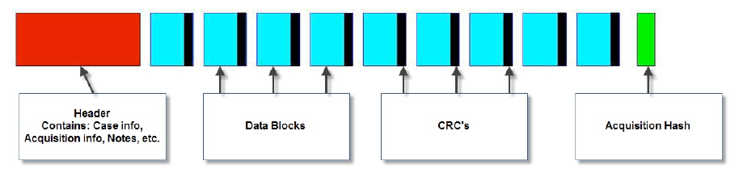
Legacy (E01) Evidence File
Three basic components
  Header: one header per evidence file
  Checksum (CRC): CRC for each byte in data block
  Data blocks: default 64 sectors
Acquisition hash value: optional
  MD5 and/or SHA-1

Slide 12
Evidence file is marked read-only once being created
When an evidence file is added to a case, EnCase automatically verifies the CRC values and the hash value(s)
  Verification hash value(s) -- recomputed for verification – added to the case
Any time, you can verify the integrity of the drive or volume with EnCase

Slide 13
Compression
EnCase uses an industry-standard compression algorithm (Zlib) to reduce evidence file size
Compression has NO effect on the file evidence file (lossless compression)
  Hash computation occurs before compression of the data

Slide 14
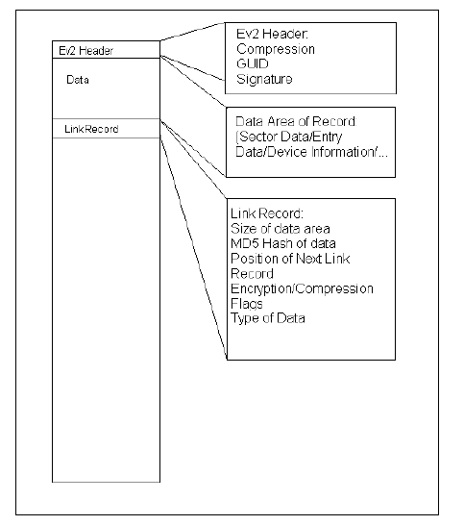
Current Format .Ex01 and .Lx01
Allows for encryption and supports a new compression algorithm bzip2

Slide 15
Other file types
Case file
  Text file containing
    Evidence files
    Files representing searches and keywords
    Hash and signature analysis results
    Etc.
Case backup file
  Manual or auto-saved backup of the open case file
Configuration file (essentially an input file that gives input to the program for user settings)
  Specific user settings, global user settings …

Slide 16
Case Management (1)
An evidence case includes:
  evidence files
  a case file
  EnCase® program configuration files

Slide 17
Case Management (2)
The case file contains :
  pointers to one or more evidence files or previewed devices
  bookmarks
  search results
  sorts
  hash analysis results
  signature analysis reports

Slide 18
Working with Evidence
EnCase applications support:
  EnCase Evidence Files (E01/Ex01): includes contents of an acquired device, investigative metadata and the device-level hash value.
  Logical Evidence Files (LEF/L01/Lx01): created from files seen in a preview or existing evidence file.
  Raw images
  Single files, including directories

Slide 19
Working with Evidence
Preview a device
Add a device
Acquire a device
Hashing a device
Restore: physical or logical

Slide 20
Viewing Files
Encase Supports viewing the following files:
  Text (ASCII and Unicode)
  Hexadecimal
  Doc, native formats for Oracle Outside In 8.2.2 technology supported formats
  Transcript, extracted content with formatting and noise suppressed
  Various image file formats

Slide 21
View Compound Files
Outlook Express (DBX)
Outlook (PST)
Exchange 2000/2003 (EDB)
Lotus Notes (NSF) for versions 4, 5, and 6
Mac DMG Format
Mac PAX Format
JungUm and Hangul 97 and 2000 Korean Office documents
Zip files such as ZIP, GZIP, and TAR files
Thumbs.db files
Others not specified
Notes:
A compound file = a file used by other apps (such as .ZIP or outlook .PST, etc.).
EnCase is convenient because it can read and analyze many different types of file formats without having to use third party or proprietary tools (which is simply less convenient).

Slide 22
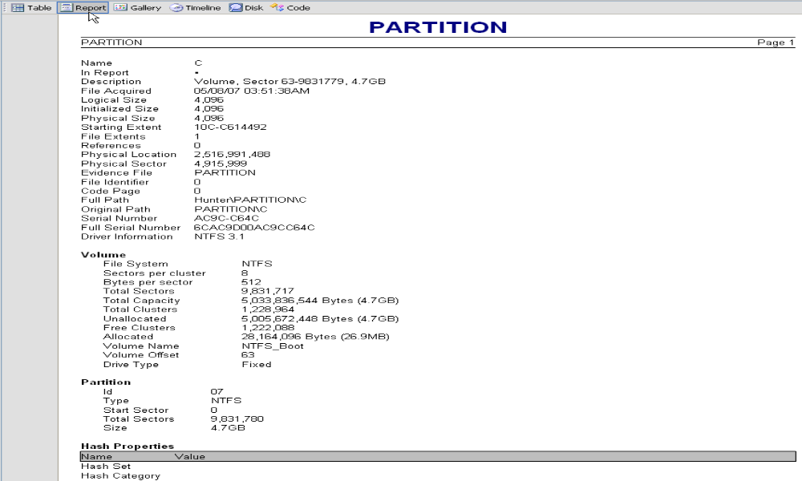
Reporting

